Slide 1

Introduction to DevOps

Slide 2
About Me
I have an Overall 14 Years of IT Experience and last
5 years , as a freelance trainer on Project Management, Agile Scrum and DevOps
Certifications on :PRINCE2 Practitioner, CSM,PSM, ITIL, Six Sigma (GreenBelt)
Currently I have been working as a Project Manager , DevOps Consultant(implementation).
Extensive Experience in Training and Consulting.
Have an 5 years of Onsite Experience, worked at Client Location.
Experience in Traditional and Agile Methodologies software development.
In-depth knowledge of all phases of software development life cycle (SDLC) with design, development & implementation of various applications.

Slide 3
What is DevOps?
The key to understanding what is DevOps lies in the intention of DevOps, that is to create superior-quality software, more quickly and with more reliability while causing greater communication and collaboration between teams. Teams we refer to these two: Development team & IT Operations team.
DevOps enables continuous software delivery with less complex problems to fix and faster resolution of problems.
DevOps is a software development approach which involves Continuous Development, Continuous Testing, Continuous Integration, Continuous Deployment and Continuous Monitoring of the software throughout its development life cycle.

Slide 4
Problem we faced before DevOps?
▸ Everything needs software nowadays.
▸ Software has to run on a server to become a service.
▸ Delivering a service from inception to its users is too slow and error-prone.
▸ There are internal friction points that make this the case.
▸ This loses you money. (delay = loss)
▸ IT is frequently the bottleneck in the transition of “concept to cash.”

Slide 5
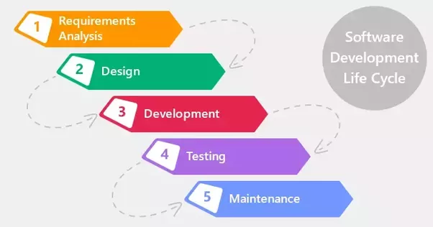
Evolution of Software Development
Software evolution is the term used in software engineering (specifically software maintenance) to refer to the process of developing software initially, then repeatedly updating it for various reasons.

Slide 6
Evolution of Software Development
The Previous diagram you will see the phases it will involve:
In phase 1 – Complete Requirement is gathered and SRS is developed
In phase 2 – This System is Planned and Designed using the SRS
In phase 3 – Implementation of the System takes place
In phase 4 – System is tested and its quality is assured
In phase 5 – System is deployed to the end users
In phase 6 – Regular Maintenance of the system is done
Water-fall model worked fine and served well for many years however it had some challenges.

Slide 7


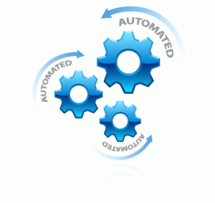


Evolution of Software Development
1
Difficult to maintain uptime for the production environment
Huge waiting time for code deployment
1
Tools to automate infrastructure management are not effective
Waterfall Challenges
2
Developers
Operations
3
2
Difficult to diagnose and provide feedback on the product
Pressure of work on old, pending and new code
No. of Servers to be monitored are increases
4

Slide 8
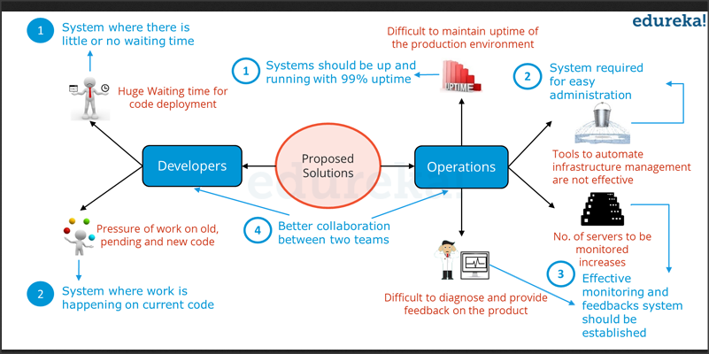
Proposal Solutions to the Waterfall Model

Slide 9
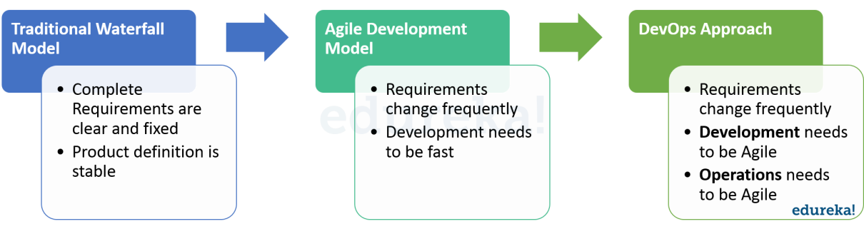
Evolution of Software Development
DevOps evolved from existing software development strategies/ methodologies over the years in response to business needs. Let us briefly look at how these models evolved and in which scenarios they would work best.

Slide 10
Evolution of Software Development
Both Development and Operations had challenges in the Waterfall Model. From Developers point of view there were majorly two challenges:
After Development, the code deployment time was huge.
Pressure of work on old, pending and new code was high because development and deployment time was high.
On the other hand, Operations was also not completely satisfied. There were four major challenges they faced as per the above diagram:
It was difficult to maintain ~100% uptime of the production environment.
Infrastructure Automation tools were not very affective.
Number of severs to be monitored keeps on increasing with time and hence the complexity.
It was very difficult to provide feedback and diagnose issue in the product.

Slide 11
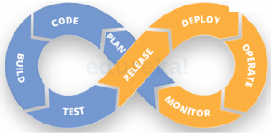
What led DevOps to come into existence
DevOps integrates developers and Operations Team to improve collaboration and productivity.
According to the DevOps culture, a single group of Engineers (developers, system admins, QA’s. Testers etc turned into DevOps Engineers) has end to end responsibility of the Application (Software) right from gathering the requirement to development, to testing, to infrastructure deployment, to application deployment and finally monitoring & gathering feedback from the end users, then again implementing the changes

Slide 12
What is DevOps?
What is DevOps
DevOps is a practice combining both Development and Systems Operations. This course is designed to make you a practitioner of DevOps by providing you hands-on training on tools that have emerged as part of DevOps lifecycle.The main characteristic of the DevOps movement is to strongly advocate automation and monitoring at all steps of software construction, from integration, testing, releasing to deployment and infrastructure management.
Why DevOps required?
1. Quicker mitigation of software defects. 2. Better resource management. 3. Reduced human errors. 4. Enhanced version control. 5. Stable operating environment.
DevOps can be defined as …
“An alignment of development and IT operations with better
communication and collaboration. “
Because DevOps is philosophy and not a solution, there is no concrete path to follow. This flexibility allows organizations to adopt the philosophy in a way that best supports them

Slide 13
What is DevOps?
DevOps is a culture which promotes collaboration between Development and Operations Team to deploy code to production faster in an automated & repeatable way. The word 'DevOps' is a combination of two words 'development' and 'operations.'
DevOps helps to increases an organization's speed to deliver applications and services. It allows organizations to serve their customers better and compete more strongly in the market.
DevOps is a philosophy of the efficient development, deployment and operation, of the highest quality software possible.
Notes:
In simple words, DevOps can be defined as an alignment of development and IT operations with better communication and collaboration.

Slide 14
What is DevOps?
DevOps a holistic approach to continuous customer satisfaction. Continuous customer satisfaction (CCS) is related to the ongoing happiness of the largest percentage of your user base possible.
This is typically manifested through the fast delivery of newly requested features with the least amount of downtime.
Continuous customer satisfaction represents a customer-centric approach to software. Customers who receive the features they want quickly, on a stable, and secure platform are generally satisfied by the overall experience. These “happy” clients are much more likely to become repeat customers and some may go as far as recommending you to other potential customers.
When DevOps is properly adopted, it supports higher quality, faster lead time — that is, the time it takes a customer’s request to make it into production — greater stability, and increased security

Slide 15
Compare traditional Software waterfall model with DevOps?
Traditional Process | DevOps
After placing an order for new servers, the Development team works on testing. The Operations team works on extensive paperwork as required in enterprises to deploy the infrastructure. | After placing an order for new servers Development and Operations team work together on the paperwork to set-up the new servers. This results in better visibility of infrastructure requirement.
Projection about failover, redundancy, data center locations, and storage requirements are skewed as no inputs are available from developers who have deep knowledge of the application. | Projection about failover, redundancy, disaster recovery, data center locations, and storage requirements are pretty accurate due to the inputs from the developers.
Operations team has no clue on the progress of the Development team. Operations team develop a monitoring plan as per their understanding. | In DevOps, the Operations team is completely aware of the progress the developers are making. Operations team interact with developers and jointly develop a monitoring plan that caters to the IT and business needs. They also use advance Application Performance Monitoring (APM) Tools
Before go-live, the load testing crashes the application. The release is delayed. | Before go-live, the load testing makes the application a bit slow. The development team quickly fixes the bottlenecks. The application is released on time.
Notes:
In simple words, DevOps can be defined as an alignment of development and IT operations with better communication and collaboration.

Slide 16
Why DevOps?
Before DevOps, the development and operation team worked in complete isolation.
Testing and Deployment were isolated activities done after design-build. Hence they consumed more time than actual build cycles.
Manual code deployment leads to human errors in production
Team members are spending a large amount of their time in testing, deploying, and designing instead of building the project.
Coding & operation teams have their separate timelines and are not in sync causing further delays.
There is a demand to increase the rate of software delivery by business stakeholders. As per Forrester Consulting Study, Only 17% of teams can use delivery software fast enough. This proves the pain point.
Notes:
In simple words, DevOps can be defined as an alignment of development and IT operations with better communication and collaboration.

Slide 17
Benefits of DevOps?
Improve collaboration between all stakeholders from planning through delivery and automation of the delivery process in order to:
Improve deployment frequency
Achieve faster time to market
Lower failure rate of new releases
Shorten lead time between fixes
Improve mean time to recovery
Notes:
In simple words, DevOps can be defined as an alignment of development and IT operations with better communication and collaboration.

Slide 18
Why DevOps is used and Where?
DevOps allows Agile Development Teams to implement Continuous Integration and Continuous Delivery. This helps them to launch products faster into the market.
DevOps (development and operations) is an enterprise software development phrase used to mean a type of agile relationship between development and IT operations. The goal of DevOps is to change and improve the relationship by advocating better communication and collaboration between these two business units.
DevOps in Real Life
Apple was among the first company to develop the DevOps team
Ecommerce companies like Amazon, EBay followed the suite & now almost every product based company is trying to use DevOps team to reduce the time to market.
There are companies which have achieved Bi-Weekly release cycle targets after introducing DevOps which used to be a month before the introduction of DevOps in their organization.

Slide 19
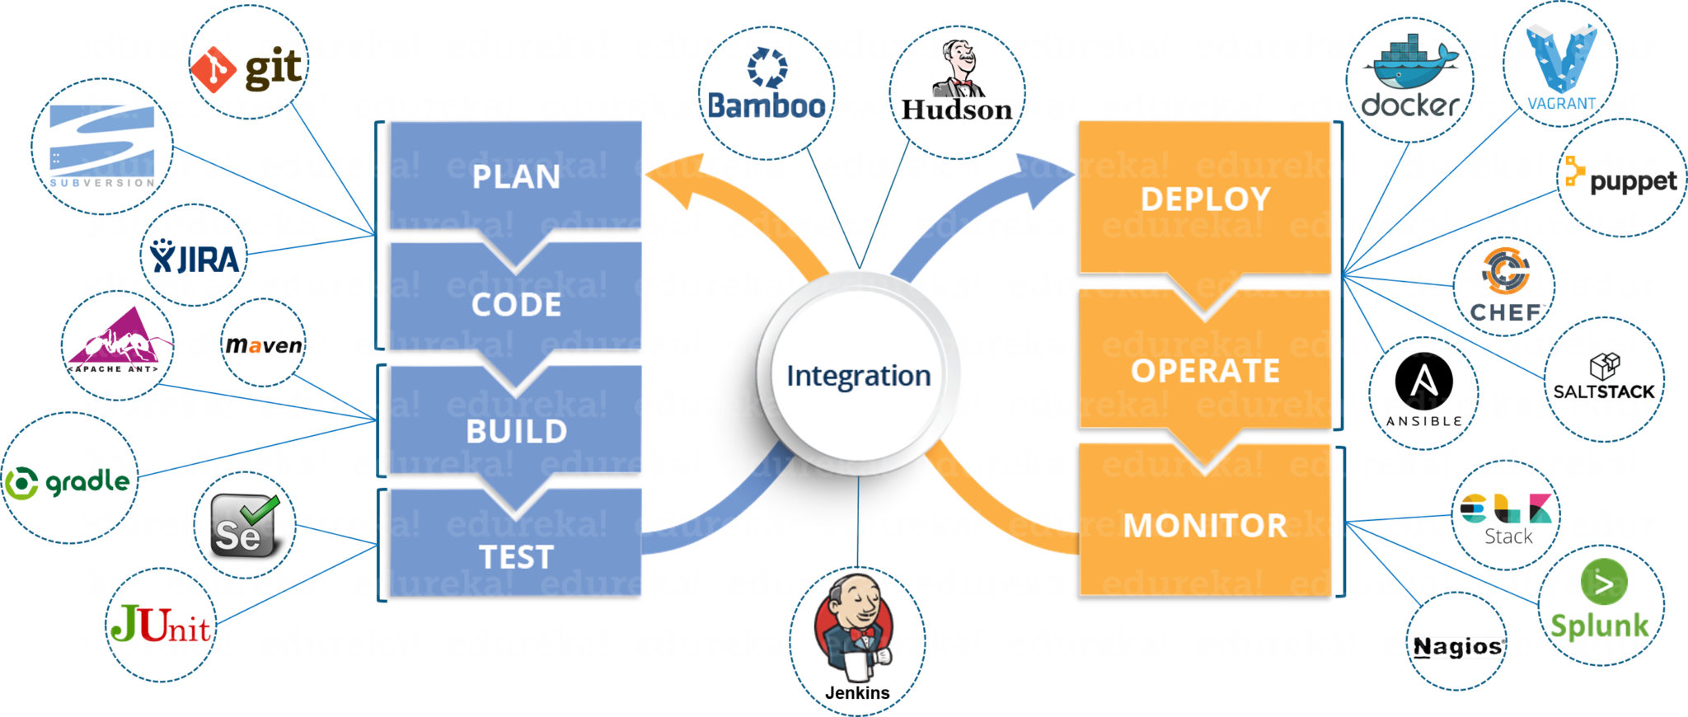
Configuration tools for DevOps
“Configuration management is the process of standardizing resource configurations and enforcing their state across IT infrastructure in an automated yet agile manner.”
DevOps Configuration Tools:

Slide 20
DevOps Configuration Management Tools
It is vital to automate all the testing processes and configure them to achieve speed and agility. This process is known as DevOps automation.
Configuration Tools we discuss during the course:
Jenkins Server – CI & CD management
Git - Code Repository Management
Build Tools- Maven/ANT
Linux & Shell Scripting
Chef/Puppet / Configuration Management
Ansible - Configuration Management
Docker – Containerization/Virtualization
Vagrant- Virtualization Tool
Nagios – Monitoring Tool

Slide 21
DevOps Life Cycle and Work Flow
A Single group of Engineers (developers, system admins, QA’s. Testers etc turned into DevOps Engineers) has end to end responsibility of the Application (Software) right from gathering the requirement to development, to testing, to infrastructure deployment, to application deployment and finally monitoring & gathering feedback from the end users, then again implementing the changes
DevOps helps to increases an organization's speed to deliver applications and services.
Relationship between Agile and DevOps

Slide 22
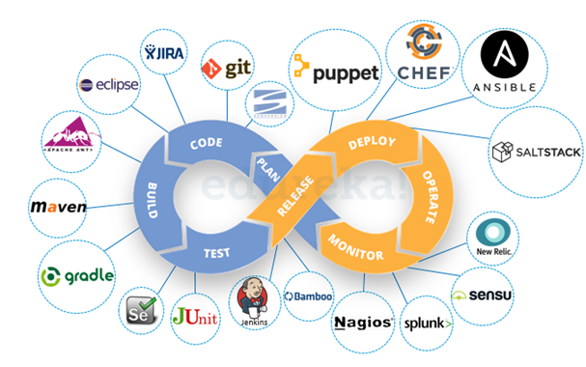
Devops Tools

Slide 23
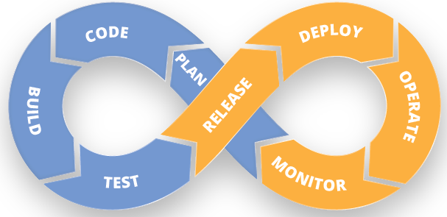
DevOps Life Cycle
DevOps Lifecycle can be broadly broken down into the below DevOps Stages:
Continuous Delivery
Continuous Integration
Continuous Testing
Continuous Monitoring
Configuration Management
Virtualization and Containerization

Slide 24
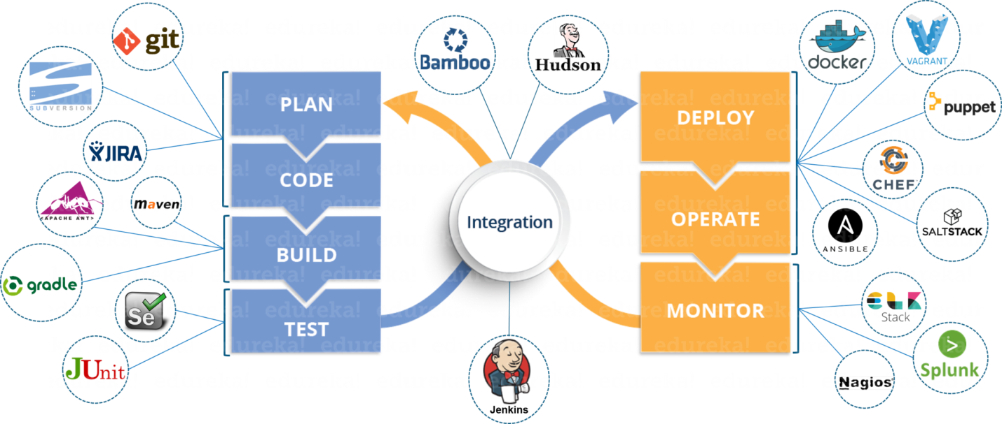
DevOps Life Cycle
These DevOps stages are carried out on loop continuously until the desired product quality is achieved. The diagram given below will show you which tools can be used in which stage of the DevOps life cycle

Slide 25
DevOps Principles and Practices
There are six principles which are essential when adopting DevOps:
1. Customer-Centric Action: DevOps team must take customer-centric action for that they should constantly invest in products and services.
2. End-To-End Responsibility: The DevOps team need to provide performance support until they become end-of-life. This enhances the level of responsibility and the quality of the products engineered.
3. Continuous Improvement: DevOps culture focuses on continuous improvement to minimize waste. It continuously speeds up the improvement of product or services offered.
4. Automate everything: Automation is a vital principle of DevOps process. This is not only for the software development but also for the entire infrastructure landscape.
5. Work as one team: In the DevOps culture role of the designer, developer, and tester are already defined. All they needed to do is work as one team with complete collaboration.
6. Monitor and test everything: It is very important for DevOps team to have a robust monitoring and testing procedures.

Slide 26
Linux Introduction
Linux is an Operating System’s Kernel. You might have heard of UNIX. Well, Linux is a UNIX clone.
it was actually created by Linus Torvalds from Scratch.
Linux is free and open-source, that means that you can simply change anything in Linux and redistribute it in your own name! There are several Linux Distributions, commonly called “distros”. A few of them are:
Ubuntu Linux
Red Hat Enterprise Linux
Linux Mint
Debian
Fedora

Slide 27
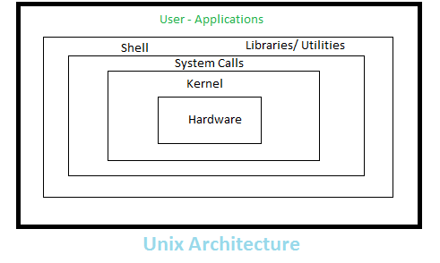
Linux/Unix Architecture
Word Processors,Databases, Java
Shell Commands(cat, ls , grep, fgrep and other)
Interface between shell and hardware(Device, memory management etc)
Components

Slide 28
Linux File System
Unix/Linux file colours:
Blue or Dark Blue – Directory
Green – Executable files
Skyblue- linked files
Yellow with black background – linked file
Pink – Graphic image file
Red – Archive or zip file
/Root Dir
/bin
/dev
/boot
/home
/etc
/usr
/bin = All Executable files
/dev= devices drivers
/boot= system bootable files
/home= home directory for users, groups
/etc=configuration related information(sysadmin related)
/usr=default directory, when new software is installed
it install here by default.

Slide 29
Linux File System
To see the permission of a file:
$ls –l
-rwxr-xr-x 1 10490 floppy 17242 May 8 2013 acroread
represents a regular file. It gives you a hint of the type of object it is
d (directory)
c (character device)
l (symlink)
p (named pipe)
s (socket)
b (block device)
D (door)
- (regular file)

Slide 30
Linux File System
r represents read permission. w represents write permission and x represents executable permission.
First combination of rwx represents permission for the owner . Second combination of rwx represents permission for the group . Third combination of rwx represents permission for the other of the file.
Octal notation
Permission of file can also be represented in octal notation. In octal notation
Read or r is represented by 4, Write or w is represented by 2 Execute x is represented by 1.
Sum of these three is use to represent the permission.
For owner it is 4+2+1=7 (111 in binary) For group it is 4+0+1=5 (101 in binary) and For other it is 4+0+1=5 (101 in binary).

Slide 31
Linux File System
r represents read permission. w represents write permission and x represents executable permission.
User/File Permissions
0 = No Permission
1 = execute
2 = write
= write & execute
= read
= read & execute
= read & write
7 = read , write & execute

Slide 32
Linux Commands
Linux is Mainly used in Servers. About 90% of the Internet is powered by Linux Servers. This is because Linux is fast, secure, and free!
Windows Servers are costly.
OS that runs in about 80% of the Smartphones in the World, Android, is also made from the Linux Kernel
Security is that most of the viruses in the world run on Windows, but not on Linux!
Shell is a program that receives commands from the user and gives it to the OS to process and it shows the output.

Slide 33
Linux Basic Commands
Basic Commands:
who
whoami
cal
date
pwd(present working directory)
ls (displays all files/directories)
To check the cmds and its help use ‘man’ command
$man who
$who –b
$who –count
$who –q
Note: $ is the user prompt
# is the Admin prompt

Slide 34
Linux Commands
Basic Commands used in Linux and Shell.
pwd - To know which directory you are working.
ls - command is used to know what files are there in the directory.
cd – command used to go to the directory
eg: cd \my\Trainings
mkdir command is used when you need to create a folder or a directory eg: mkdir Trainings
rmdir is the command used for deleting a directory. rmdir can only be used to delete an empty directory
rm command is used to delete files and directories.
“rm -r” is used to delete a directory. In this case, it deletes both the folder and the files in it. Eg: rm –r dir1
touch command is used to create multiple empty files eg: touch newfile.txt
$touch test1.txt test3.txt test 4.txt
man - To know more about a command and on how to use it.
eg: man cd

Slide 35
Linux Commands
cp command is used to copy files through the command line. It takes two arguments, the first one is location of the file to be copied, the second is where to copy.
cp means copy and paste
Eg: $cp diyinfo.txt /home/cubeipl/my\Trainings
$cp test1.txt test3.txt
Create directories in the samelocation
$mkdir java
$cp java javacript ( it throws an error here…)
$cp -r java javascript(it works)

Slide 36
Linux Commands
mv command is used to move files through the command line and also used to rename a file.
It is also used to move the files from one location to another location
mv means cut and paste
eg: mv diyinfo.txt cfile.txt
$mv –v testfile /home/cubeipl/dir1/testupdatefile
locate command is used to locate a file in a Linux System, just like the search command in Windows.
eg: locate -A Hello
“echo” is a command that helps us move some data, usually text into a file.
eg: echo hello, my name is alok >> new.txt
cat command is used to display the contents of a file, usually used to easily view programs.
eg: cat new.txt
nano and vi are already installed text editors in the Linux command line
eg: nano new.txt

Slide 37
Linux Commands
sudo is a widely used command in the Linux command line. sudo stands for “SuperUser Do”. if we want any command to be done with administrative or root privileges, then you can use the sudo command.
eg: sudo bash
df command is used to see the available disk space in each of the partitions in your system. If you want it shown in megabytes, you can use the command “df -m”
du is a command to know the disk usage of a file in your System. If you want to know the disk usage for a particular folder or file in Linux, then you can type in the command df and the name of the folder or file.
eg: du myTrainings

Slide 38
Linux Commands
tar is a command used to work with tarballs (or files compressed in a tarball archive) in the Linux Command Line.
Linux “tar” stands for tape archive, which is used by large number of Linux/Unix system administrators to deal with tape drives backup.
It can be used to compress and uncompress different types of tar archives like .tar, .tar.gz, .tar.bz2.etc. It works on the basis of the arguments given to it.
1. tar -cvf for creating a .tar archive,
2. tar -xvf to untar a tar archive,
3. tar -tvf to list the contents of the archive
[Other 18 commands were there for tar , discussed later]

Slide 39
Linux Commands
uname is a command used to show the Information about the system your Linux distro is running. Using the command “uname -a” prints most of the information about the system. This prints the Kernel release date, version, processor type. Eg: uname –a
apt is a command used to work with packages in the Linux command line
apt-get is a command used to install packages. requires root privileges, so we use the sudo command with it.
Ping is a command used to check your connection to a server.
To see the file size
#du -sh

Slide 40
Linux Commands
Tar Commands
Linux “tar” stands for tape archive, which is used by large number of Linux/Unix system administrators to deal with tape drives backup.
The tar command used to rip a collection of files and directories into highly compressed archive file commonly called tarball or tar, gzip and bzip in Linux.
tar is most widely used command to create compressed archive files and that can be moved easily from one disk to another disk or machine to machine.
Creating a tar Archive file:
eg: tar –cvf techlog.tar /home/cubeipl/
c – Creates a new .tar archive file.
v – Verbosely show the .tar file progress.
f – File name type of the archive file.

Slide 41
Linux Commands
Creating a tar Archive file
eg: tar –cvf myFiles.tar 11
Create a compressed gzip archive file we use the option as z.
eg: tar cvzf myFile22.tar.gz 22
Note : tar.gz and tgz both are similar
Create tar.bz2 Archive File
bz2 feature compress and create archive file less than the size of the gzip. The bz2 compression takes more time to compress and decompress files as compared to gzip which takes less time.
To create highly compressed tar file we use option as j.
eg: tar cvfj myFiles33.tar.bz2 33
Note: tar.bz2 and tbz is similar as tb2

Slide 42
Linux Commands
Untar tar Archive File
untar or extract a tar file, just issue following command using option x (extract).
eg: tar –xvf myFiles11.tar
Untar files in specified Directory
eg: tar -xvf myFiles11.tar -C /home/cubeipl/myTrainings/
Uncompress tar.gz Archive File
eg: tar –xvf myFiles33.tar.gz
Uncompress tar.bz2 Archive File
eg: tar –xvf myFiles44.tar.bz2
List Content of tar Archive File
eg: tar -tvf myFiles11.tar

Slide 43
Linux Commands
Add Files or Directories to tar Archive File
eg: tar -rvf myFiles33.tar.bz2 abc.txt
Tar Usage and Options
c – create a archive file.
x – extract a archive file.
v – show the progress of archive file.
f – filename of archive file.
t – viewing content of archive file.
j – filter archive through bzip2.
z – filter archive through gzip.
r – append or update files or directories to existing archive file.
W – Verify a archive file.
wildcards – Specify patterns in unix tar command.

Slide 44
Linux Commands
Tips and Tricks in Using Linux Command Line
You can use clear command to clear the terminal if it gets filled up with too many commands!
TAB can be used to fill up in Terminal. For example, You just need to type “cd Doc” and then TAB and the terminal fills the rest up and makes it “cd Documents”.
Ctrl+C can be used to stop any command in terminal safely. If it doesn’t stop with that, then Ctrl+Z can be used to force stop it.
You can exit from the terminal by using the exit command.
You can power off or reboot the computer by using the command sudo halt and sudo reboot.

Slide 45
User Management (Linux)
User management is nothing but adding, deleting the users and assigning the passwords for the users in Linux. The same follows with groups. The important thing is this command needs root privilege for accessing other users or groups. Only the same user process can be done without the privilege.
To add a new User and to set password
Syntax:
adduser <username> or useradd <username>
eg:root@localhost cubeipl] adduser user1
Once a new user created, it’s entry automatically added to the ‘/etc/passwd‘ file.
To set the password for the newly created username
Syntax
passwd <username>
Eg: root@localhost cubipl]passwd user1
To delete a user account
To delete an user account, use the following User management command.
syntax: userdel -r [username]
eg: userdel –r cubeipl
Here, -r option is used to delete user along with the user’s home directory and mail spool.

Slide 46
User Management (Linux)
By default username information is stored in /home/username
The full account information is stored in the /etc/passwd file.
[username]:[x]:[UID]:[GID]:[Comment]:[Home directory]:[Default shell]
eg: knowledgeit:x:1006:1006::/home/knowledgeit:/bin/bash
username = knowledgeit
x = account is protected by a shadowed password (in /etc/shadow), which is needed to logon as [username].
[UID]:[GID]=
that represent the User Identification and the primary Group Identification to which [username] belongs, respectively.
[Home directory] = absolute path to [username]’s home directory
[Default shell]= the shell that will be made available to this user when he or she logins the system

Slide 47
User Management (Linux
Adding a group
-g<gid> Group ID for the group, which must be unique and greater than 499 .
-r Create a system group with a GID less than 500
Only after changing into root , we can create group.
eg: [root@localhost cubeipl]# groupadd jsgroup
Creating a group with a specified GID: To explicitly specify the GID of a group, execute the groupadd command with the –g option, as follow:
eg: [root@localhost cubeipl]# groupadd -g 1506 manager
Changing the group’s name: To change the group’s name, run the groupmod command with the -n option as a super user, as shown below:
eg: [root@localhost cubeipl]# groupmod -n <newgrpname> <currentgroupname>
Changing the group’s GID: To change the GID of a group, run the groupmod command with –g, as follow:
eg: [root@localhost cubeipl]# groupmod -g 1050 manager
Deleting a group: Before deleting a primary group, delete the users of that primary group. To delete a group, run the groupdel command with the group name, as shown below:
eg: [root@localhost cubeipl]# groupdel employee

Slide 48
User Management
To see the list of users
[root@localhost]#cat /etc/passwd
To Add the user into group
#cat /etc/group
# sudo usermod -a -G digitalgroup gautham
To see the list of group
# cat /etc/group
# grep digitalgroup /etc/group

Slide 49
Shell Scripting(Linux)
What is a Shell?
An Operating is made of many components, but its two prime components are -
- Kernel
- Shell
A Kernel is at the nucleus of a computer. It makes the communication between the hardware and software possible. While the Kernel is the innermost part of an operating system, a shell is the outermost one.
A shell in a Linux operating system takes input from you in the form of commands, processes it, and then gives an output.
It is the interface through which a user works on the programs, commands, and scripts. A shell is accessed by a terminal which runs it.
Types of Shell
There are two main shells in Linux:
1. The Bourne Shell: The prompt for this shell is $ and its derivatives are listed below:
POSIX shell also is known as sh
Korn Shell also knew as sh
Bourne Again SHell also knew as bash (most popular)
2. The C shell: The prompt for this shell is %, and its subcategories are:
C shell also is known as csh
Tops C shell also is known as tcsh

Slide 50
Shell Scripting(Linux)
What is Shell Scripting?
- Collection of Linux commands is called shell scripting.
- Shell scripting is writing a series of command for the shell to execute.
- It can combine lengthy and repetitive sequences of commands into a single and
simple script, which can be stored and executed anytime.
- This reduces the effort required by the end user.
Variables in Shell
To process our data/information, data must be kept in computers RAM memory. RAM memory is divided into small locations, and each location had unique number called memory location/address, which is used to hold our data.
In Linux (Shell), there are two types of variable: (1) System variables - Created and maintained by Linux itself. This type of variable defined in CAPITAL LETTERS. (2) User defined variables (UDV) - Created and maintained by user. This type of variable defined in lower-case letters.

Slide 51
Common Environment Variables
Some Common Ones are
1. DISPLAY the graphical display to use
2. EDITOR the path to your default editor
3. GROUP your login group
4. HOME path to your home directory
5. HOST the hostname of your system
6. IFS internal field separators(tab/space/enter etc)
7.LOGNAME the name you login with
8. PATH paths to be searched for commands
9. PS1 the primary prompt string($)
10. PS2 the secondary prompt string (defaults to >)
11. SHELL the login shell you are using
12. TERM your terminal type
Eg: echo $HOME

Slide 52
Shell Keywords
echo
if
read
else
set
unset
until
trap
case
wait
done
esac
eval
break
exec
continue
read-only
while
do
ulimit
shift
exit
umask

Slide 53
Shell Scripting(Linux)
Collection of unix/linux commands are called shell scripting.
Every file saves as .sh extension
To Check the default shell script in your linux system
#echo $0
Uses of shell:
Customizing your work environment
Automation of daily tasks
Automation of repetitive tasks
Executing the important system procedure like shutdown the system.
Performing same operating on many files

Slide 54
Shell Scripting(Linux)
system variables by giving command like $ set, some of the important System variables are:
System Variable | Meaning
BASH=/bin/bash | Our shell name
BASH_VERSION=1.14.7(1) | Our shell version name
COLUMNS=80 | No. of columns for our screen
HOME=/home/vivek | Our home directory
LINES=25 | No. of columns for our screen
LOGNAME=students | students Our logging name
OSTYPE=Linux | Our Os type
PATH=/usr/bin:/sbin:/bin:/usr/sbin | Our path settings
PS1=[\u@\h \W]\$ | Our prompt settings
PWD=/home/students/Common | Our current working directory
SHELL=/bin/bash | Our shell name
USERNAME=vivek | User name who is currently login to this PC

Slide 55
Shell Scripting(Linux)
Adding Shell Comments
#comments here
Creating the shellscript file
[root@localhost myscripts] $ vi filename.sh
Open the editor, ‘i’ to insert data( i indicates the insert)
To save the file , press ‘esc’ and ‘:w’ to write the file
To exit from the editor , press ‘esc’ and ‘:q’
To Execute the Shell Script
[root@localhost myscripts] $ bash filename.sh
$ sh filename.sh

Slide 56
Shell Scripting(Linux)
What are Shell Variables?
Variables store data in the form of characters and numbers.
Shell variables are used to store information and they can by the shell only.
For example, the following creates a shell variable and then prints it:
variable =“Linux Centos"
echo $variable
Eg:
$ #!bin/sh
echo “ What is your name?”
read name $ used to display the variable value
echo “ how do you do, $name”
read remark read is used to take the input from user
Echo “ I am $remark, too”
Save and execute the file now.
Shell scripting can help you create complex programs containing conditional statements, loops, and functions

Slide 57
Shell Scripting(Linux)
In Linux (Shell), there are two types of variable: (1) System variables - Created and maintained by Linux itself. This type of variable defined in CAPITAL LETTERS. (2) User defined variables (UDV) - Created and maintained by user. This type of variable defined in lower letters.
System Variable | Meaning
BASH=/bin/bash | Our shell name
BASH_VERSION=1.14.7(1) | Our shell version name
COLUMNS=80 | No. of columns for our screen
HOME=/home/vivek | Our home directory
LINES=25 | No. of columns for our screen
LOGNAME=students | students Our logging name
OSTYPE=Linux | Our Os type
PATH=/usr/bin:/sbin:/bin:/usr/sbin | Our path settings
PS1=[\u@\h \W]\$ | Our prompt settings
PWD=/home/students/Common | Our current working directory
SHELL=/bin/bash | Our shell name
USERNAME=vivek | User name who is currently login to this PC
copyrights@cubeipl.com
57

Slide 58
Shell Scripting(Linux)
How to use define User defined variables (UDV)
variables are defined by users
shell script allows us to set and use our own variables within the script. Setting variables allows you to temporarily store data and use it throughout the script, making the shell script more like a real computer program.
User variables can be any text string of up to 20 letters, digits, or an underscore character.
Values are assigned to user variables using an equal sign.
The backtick allows you to assign the output of a shell command to a variable.
eg:testing=`date`
examples:
var1=10 var2=-57 var3=testing var4=“still more testing”
To define UDV use following syntax Syntax: variable name=value
'value' is assigned to given 'variable name' and Value must be on right side = sign.
eg: $ no=78

Slide 59
Shell Scripting(Linux) Basic Operators
We will discuss in detail about Bourne shell (default shell) in this chapter.
We will now discuss the following operators −
Arithmetic Operators
Relational Operators
Boolean Operators
String Operators
Arithmetic Operators:
Operator | Description
+ (Addition) | Adds values on either side of the operator
- (Subtraction) | Subtracts right hand operand from left hand operand
* (Multiplication) | Multiplies values on either side of the operator
/ (Division) | Divides left hand operand by right hand operand
% (Modulus) | Divides left hand operand by right hand operand and returns remainder
= (Assignment) | Assigns right operand in left operand
== (Equality) | Compares two numbers, if both are same then returns true.
!= (Not Equality) | Compares two numbers, if both are different then returns true.

Slide 60
Shell Scripting(Linux) Basic Operators
It is very important to understand that all the conditional expressions should be inside square braces with spaces around them, for example $[ a == b ] is correct whereas, [$a==$b] is incorrect.
Relational Operators
Bourne Shell supports the following relational operators that are specific to numeric values. These operators do not work for string values unless their value is numeric.
Operator | Meaning
-eq | Checks if the value of two operands are equal or not; if yes, then the condition becomes true.
-ne | Checks if the value of two operands are equal or not; if values are not equal, then the condition becomes true.
-gt | Checks if the value of left operand is greater than the value of right operand; if yes, then the condition becomes true.
-lt | Checks if the value of left operand is less than the value of right operand; if yes, then the condition becomes true.
-ge | Checks if the value of left operand is greater than or equal to the value of right operand; if yes, then the condition becomes true.
-le | Checks if the value of left operand is less than or equal to the value of right operand; if yes, then the condition becomes true.

Slide 61
Shell Scripting(Linux) Basic Operators
Boolean Operators
Operator | Description | example
! | This is logical negation. This inverts a true condition into false and vice versa. | [ ! false ] is true.
-o | This is logical OR. If one of the operands is true, then the condition becomes true. | [ $a -lt 20 -o $b -gt 100 ] is true.
-a | This is logical AND. If both the operands are true, then the condition becomes true otherwise false. | [ $a -lt 20 -a $b -gt 100 ] is true

Slide 62
Shell Scripting(Linux Basic Operators
String Operators
Operator | Description
= | Checks if the value of two operands are equal or not; if yes, then the condition becomes true.
!= | Checks if the value of two operands are equal or not; if values are not equal then the condition becomes true.
-z | True if the length of string is zero.
-n | True if the length of string is non-zero
string1 != string2 | True if the strings are not equal

Slide 63
Shell Scripting(Linux Basic Operators
Note:
It is very important to understand that all the conditional expressions should be placed inside square braces with spaces around them. For example, $[ a <= b ] is correct whereas, [$a <= $b] is incorrect.
It is very important to understand that all the conditional expressions should be inside square braces with spaces around them, for example $[ a == b ] is correct whereas, [$a==$b] is incorrect.

Slide 64
Shell Scripting(Linux) Conditional Statements
Linux Shell supports conditional statements which are used to perform different actions based on different conditions.
Sometimes, it's necessary to check for certain conditions
The if...else statement
Conditionals, if/then/elif
if condition
then
statement1
statement2 ..........
fi
Sometimes, you may wish to specify an alternate action when the condition fails.
if condition
then
statement1
statement2 ..........
else
statement3
fi

Slide 65
Shell Scripting(Linux)
Multiple Conditional statements
it is possible to test for another condition if the first "if" fails. Note that any number of elifs can be added.
syntax:
if condition1
then
statement1
statement2 ..........
elif condition2
then
statement1….
elif condition3
then
statement1…
else
default Statement
fi

Slide 66
Shell Scripting Loops
Loop defined as: “system can repeat particular instruction again and again, until particular condition satisfies. A group of instruction that is executed repeatedly is called a loop."
Bash supports:
for loop
while loop
Note that in each and every loop,
(a) First, the variable used in loop condition must be initialized, then execution of the loop begins.
(b) A test (condition) is made at the beginning of each iteration.
(c) The body of loop ends with a statement that modifies the value of the test (condition) variable.

Slide 67
Shell Scripting Loops
for Loop
Syntax: for { variable name } in { list }
do
execute one for each item in the list until the list is
not finished (And repeat all statement between do and done) done
done
Even you can use following syntax:
Syntax:
for (( expr1; expr2; expr3 )) do ..... ...
repeat all statements between do and done
until expr2 is TRUE
done
Eg:
#!bin/sh for i in 1 2 3 4 5 do echo "Welcome $i times" done

Slide 68
Shell Scripting Loops
Nesting of for Loop
A loop statement can use any other type of command within the loop, including other loop commands. This is called a nested loop.
when using nested loops, because you’re performing an iteration within an iteration, which multiplies the number of times commands are being run.
If you don’t pay close attention to this, it can cause problems in your scripts.
Syntax:
for (( i = 1; i <= 5; i++ )) ### Outer for loop ### do for (( j = 1 ; j <= 5; j++ )) ### Inner for loop ### do echo -n "$i " done echo "" #### print the new line ### done

Slide 69
Shell Scripting Loops
While loop
A while loop is a statement that iterates over a block of code till the condition specified is evaluated to true. We can use this statement or loop in our program when do not know how many times the condition is going to evaluate to false before evaluating to true.
Loop is executed as long as given condition is true.
While loops are frequently used for reading data line by line from file:
Syntax:
while [ condition ]
do
command1
command2
command3
.. ....
done

Slide 70
How to de-bug the shell script?
While programming shell sometimes you need to find the errors (bugs) in shell script and correct the errors (remove errors - debug). For this purpose you can use -v and -x option with sh or bash command to debug the shell script. General syntax is as follows: Syntax: sh option { shell-script-name } OR bash option { shell-script-name } Option can be -v Print shell input lines as they are read. -x After expanding each simple-command, bash displays the expanded value of PS4 system variable, followed by the command and its expanded arguments.

Slide 71
Shell Scripting- Functions
Functions in Bash Scripting are a great way to reuse code.
In programming, functions are named sections of a program that performs a specific task.
A function is a group of commands that are assigned a name that acts like a handle to that group of commands
There will be cases where you need to execute a block of code that achieves a specific procedure several times in different places in your shell script.
They are particularly useful if you have certain tasks which need to be performed several times.
Instead of writing out the same code over and over you may write it once in a function then call that function every time.
Sometime shell scripts get complicated.
To avoid large and complicated scripts use functions.
You divide large scripts into a small chunks/entities called functions.
Functions makes shell script modular and easy to use.

Slide 72
Shell Scripting- Functions
Functions in Bash Scripting are a great way to reuse code.
Functions are subsets of a code that implement an independent programming logic.
For example, to create a four function calculator, independent programming logic are:
Addition function
Multiplication function
Division function
Subtraction function
Function allows us to divide a larger problem into smaller independent problem which may lead to better understandability and debugging.
One major advantage of functions are code reuse. A function, once written, need not to be defined again for doing a same task. A task can be done in repetition easily with a function call using the function name

Slide 73
Why Functions in ShellScripting?
It helps us to reuse the code.
Improve the readability of program.
Efficient use of variables inside the program.
Allows us to test the program part by part.
Displays program as a bunch of sub-steps.

Slide 74
Shell Scripting- Functions
Creating a function is fairly easy. They may be written in two different formats:
function function_name()
{
###set of commands
}
Syntax2:
function_name()
{
####set of commands
}
function is a key work that declares the function definition.
function_name is the name of the declared function.
Curly braces {} acts as delimiters that enclose the function’s code.
Set of commands are the code to be executed when the function is called.
So, a function is declared first, and then called when needed.

Slide 75
Shell Scripting- Functions
The function definition ( the actual function itself) must appear in the script before any calls to the function.
Let's look at a simple example:function_example.sh
#!/bin/bash
# Basic function
print_something () {
echo Hello I am a function
}
print_something
print_something
# compile the program
[root@localhost]#sh function_example.sh
Best Practice is : You should pick function names that are descriptive. That way it is obvious what task the function serves.

